Slide 1
Black Hills Expedition

Slide 2
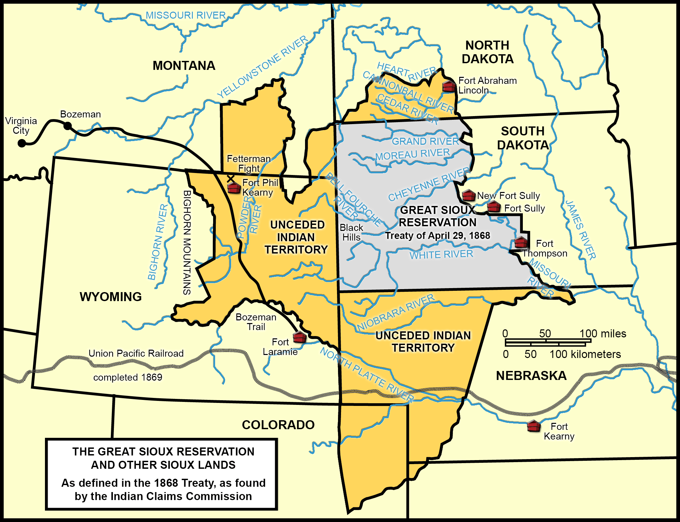
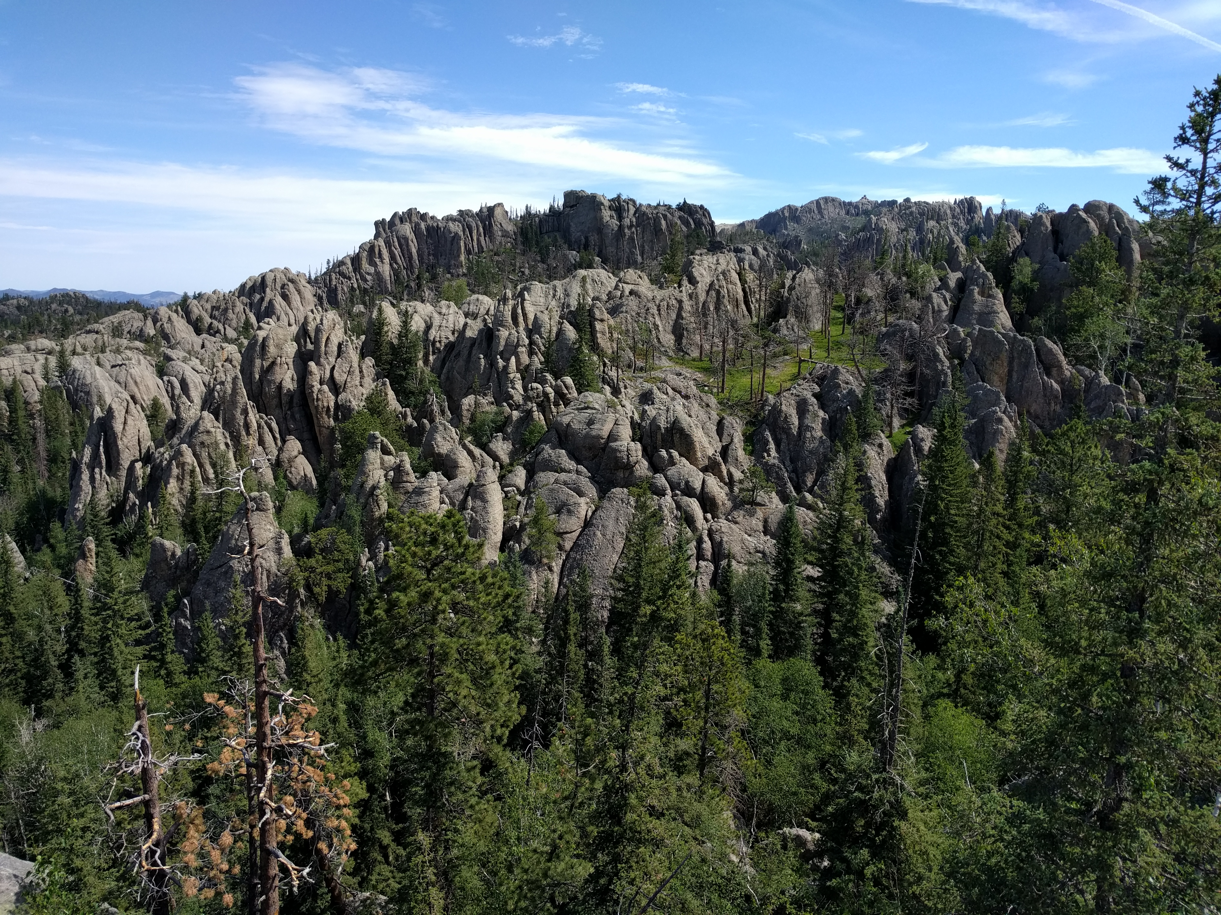
Black Hills
Notes:
The Black Hills Expedition was a United States Army expedition in 1874 led by Lieutenant Colonel George Armstrong Custer that set out on July 2, 1874 from modern day Bismarck, North Dakota, which was then Fort Abraham Lincoln in the Dakota Territory, with orders to travel to the previously uncharted Black Hills of South Dakota. Its mission was to look for suitable locations for a fort, find a route to the southwest, and to investigate the possibility of gold mining.
Rumors and poorly documented reports of gold in the Black Hills go back to the early 19th century. In the 1860s,

Slide 3
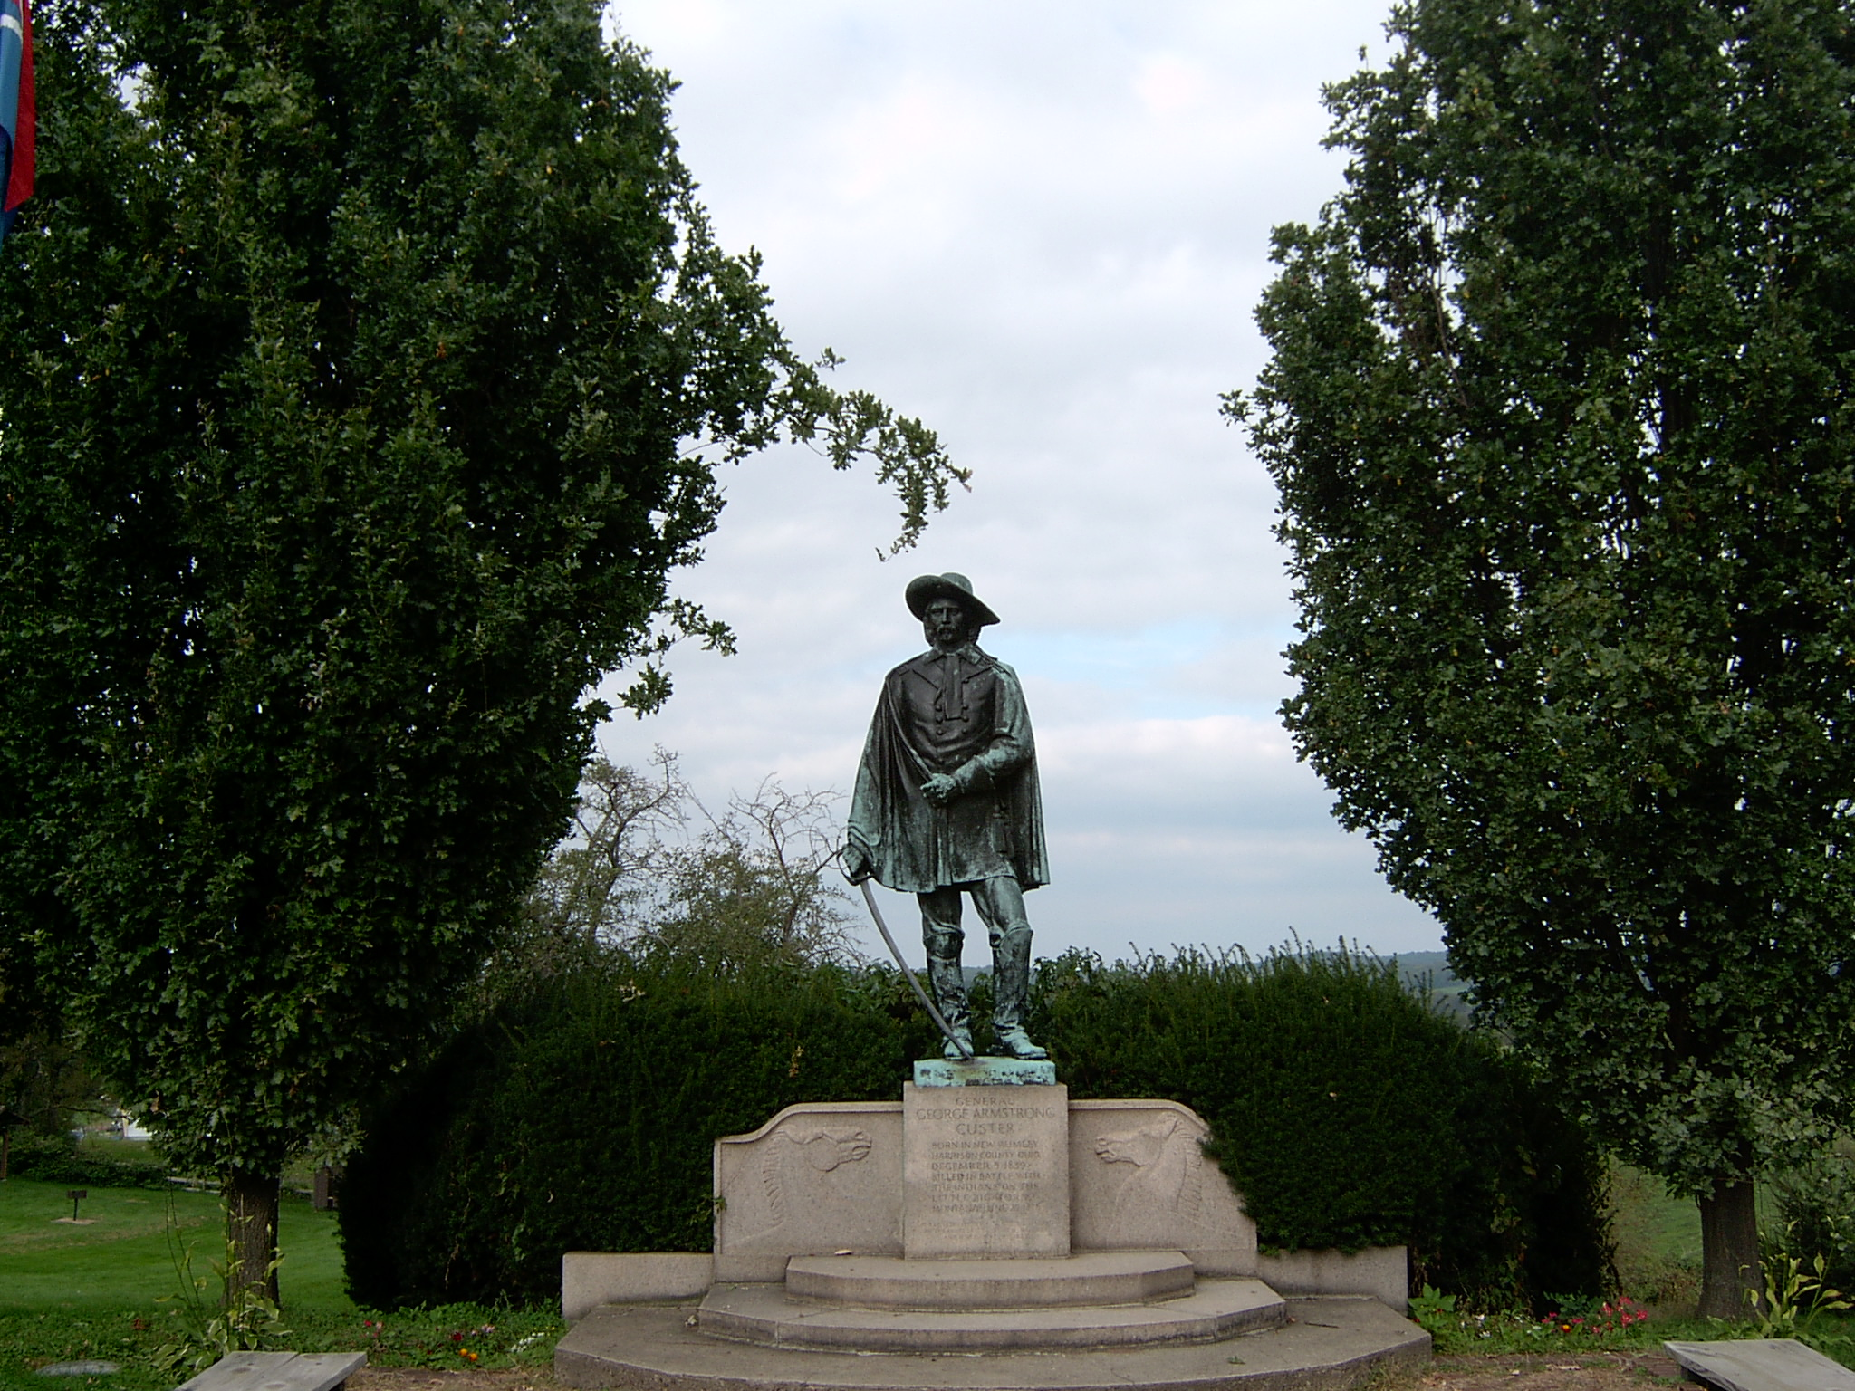
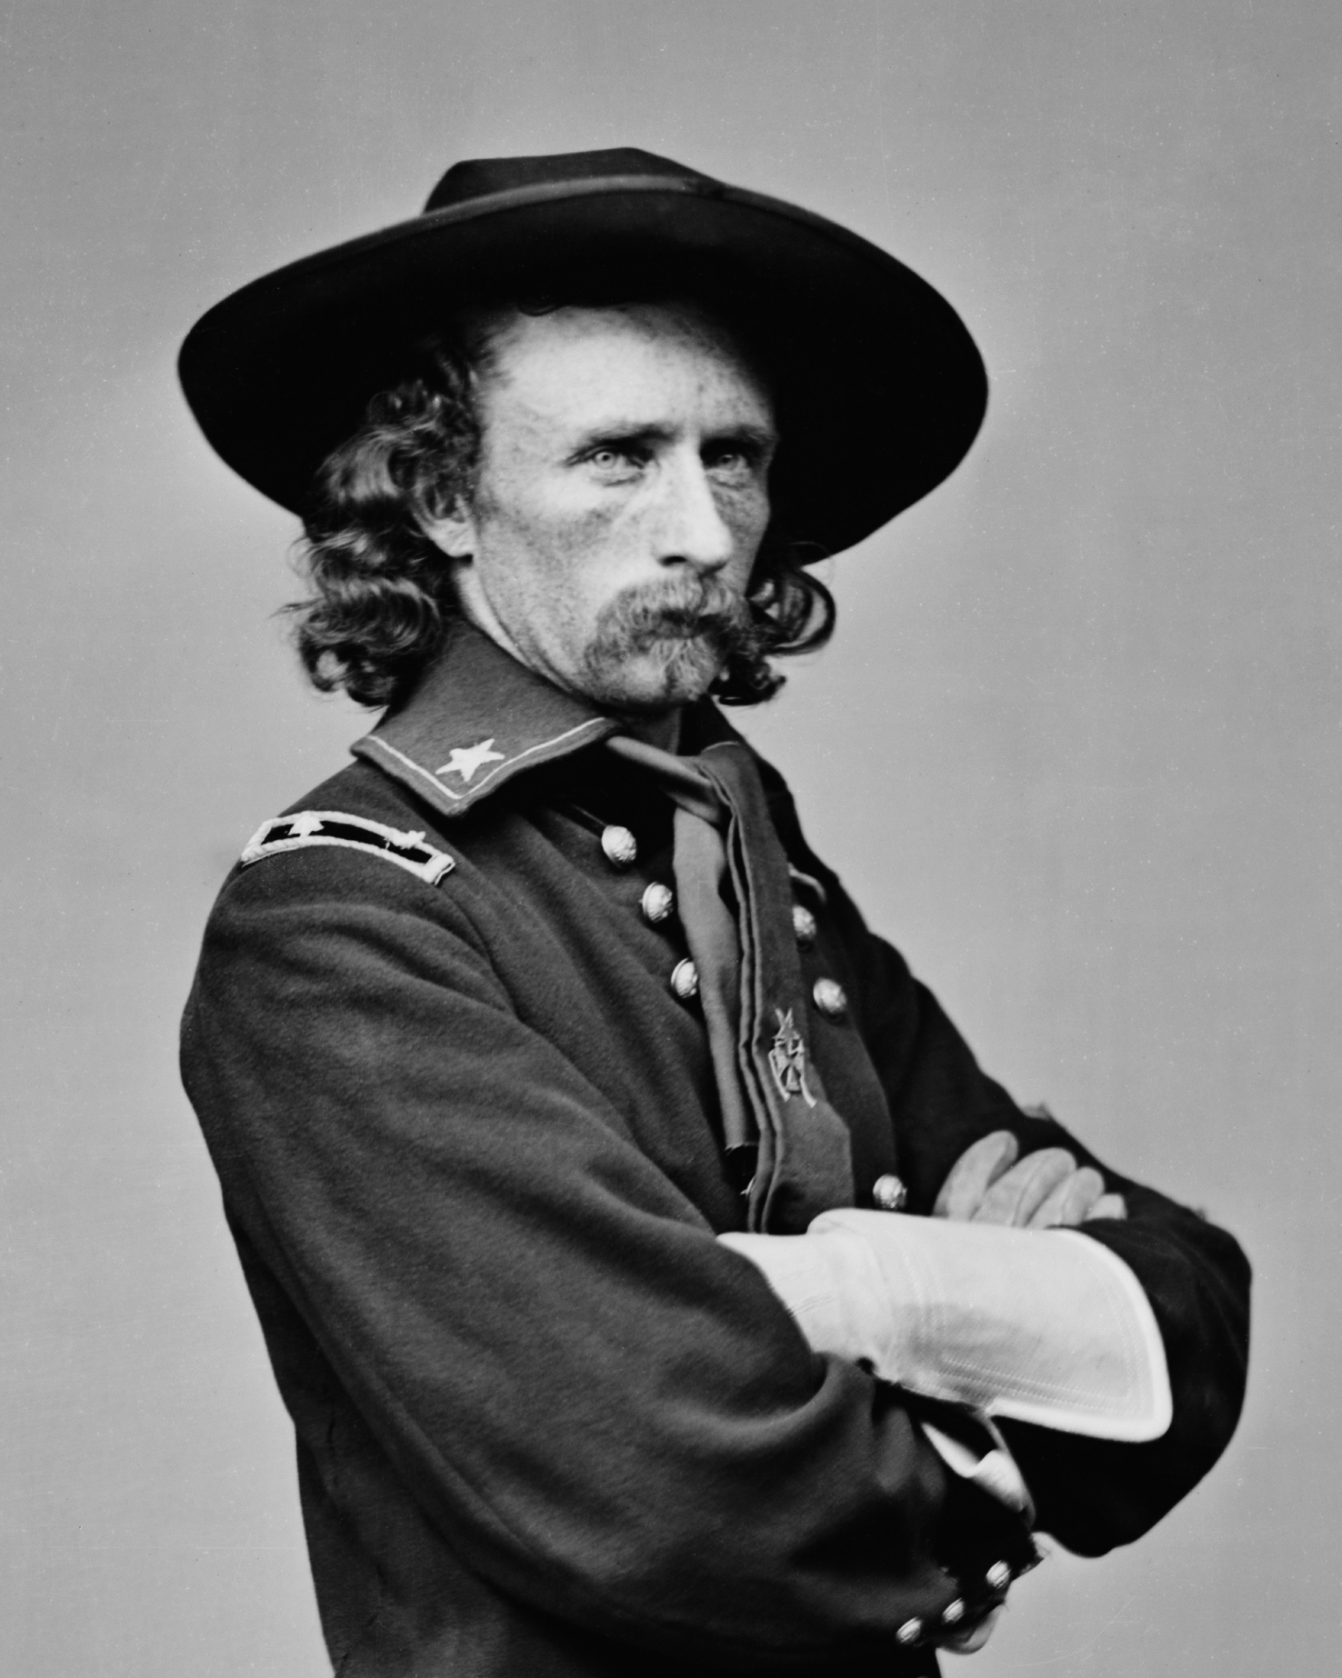
Lt. Colonel George Armstrong Custer
Cavalry Commander
Hero in the Civil War
7th Cavalry Regiment
American Indian Wars
“Media Personality”
Books about him
Notes:
Prior to the Gold Rush, the Black Hills were used by Native Americans (primarily bands of Sioux but others also ranged through the area). The United States government recognized the Black Hills as belonging to the Sioux by the Treaty of Laramie in 1868. Despite being within Indian territory, and therefore off-limits, white Americans were increasingly interested in the gold-mining possibilities of the Black Hills.

Slide 4
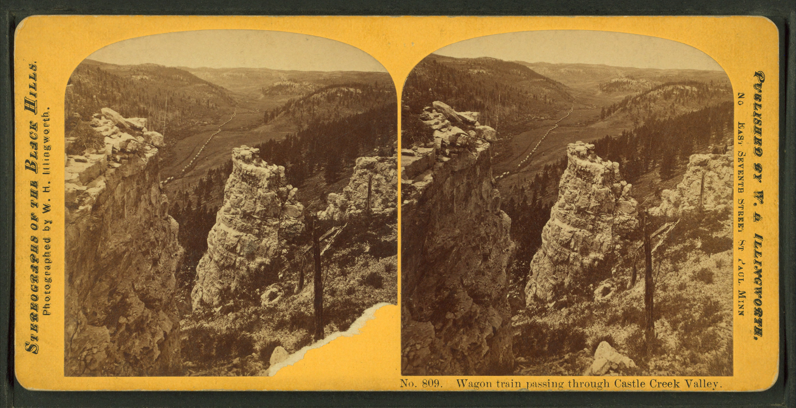

Slide 5
"There is no doubt as to the existence of various metals throughout the hills. … I referred in a former dispatch to the discovery of gold. Subsequent examinations at numerous points confirm and strengthen the fact of the existence of gold in the Black Hills."
– Custer, a letter to the Assistant Adjutant General of Dakota, August 15, 1874,
Notes:
At the time, the Black Hills were relatively unknown, with few white expeditions ever returning from them[1] The commander of Custer's engineering corps, Captain Hardy, assured him that he had heard of them and had them marked on his maps, but had never entered them during his earlier expeditions. En route to the Black Hills, Custer's party managed to locate the track of Hardy's group when they spotted two lines of sunflowers that had grown along the ruts of his passing wagons.

Slide 6
Gold Rush

Slide 7
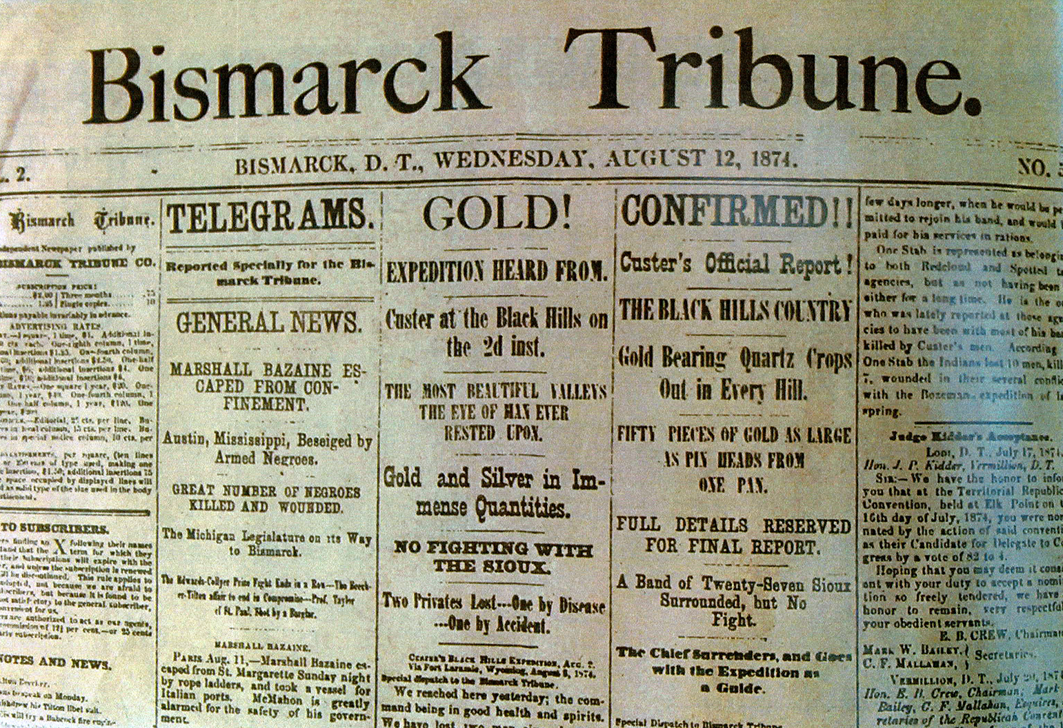
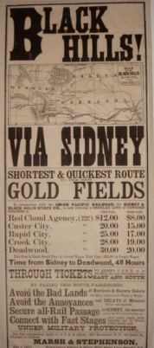
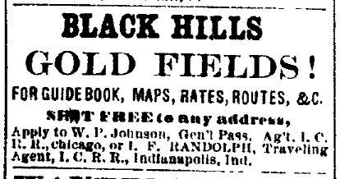

Slide 8
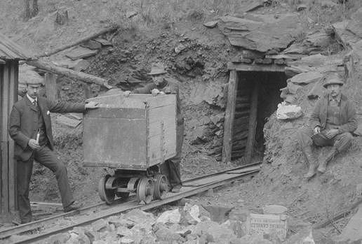

Slide 9
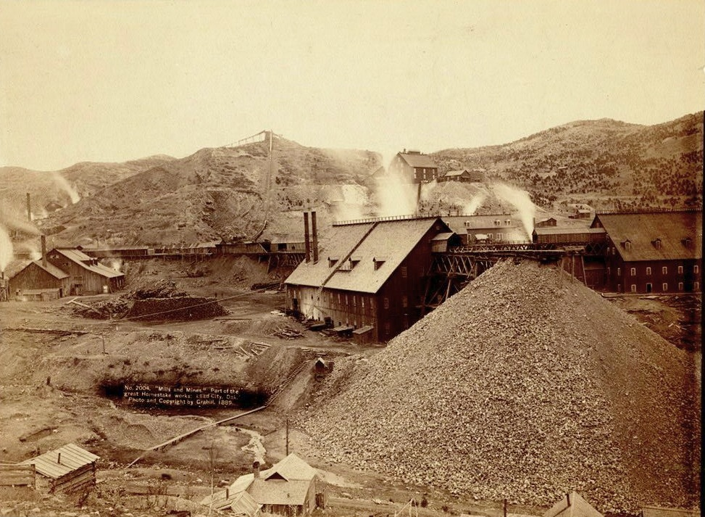

Slide 10
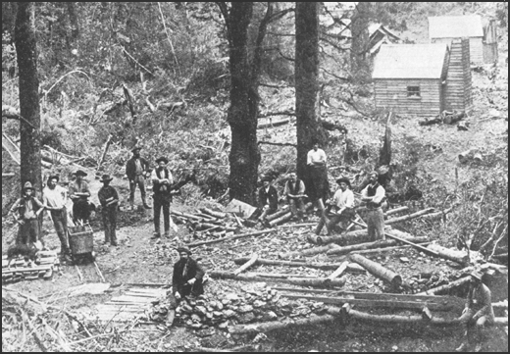
Notes:
Gold had been discovered in the Black Hills, settlers began to encroach onto Native American lands, and the Sioux and Cheyenne refused to cede ownership to the U.S.
On both the reservation and the unceded territory, white men were forbidden to trespass, except for officials of the U.S. government.

Slide 11
Notes:
Initially, the United States Army struggled to keep miners out of the region. In December 1874, for example, a group of miners led by John Gordon from Sioux City, Iowa, managed to evade Army patrols and reached the Black Hills, where they spent three months before the Army ejected them. Such evictions, however, increased political pressure on the Grant Administration to secure the Black Hills from the Lakota.
In May 1875, Sioux delegations traveled to Washington, D.C. to persuade President Ulysses S. Grant to honor existing treaties and stem the flow of miners into their territories. The US leaders said that the Congress wanted to pay the tribes $25,000 for the land and have them relocate to Indian Territory (in present-day Oklahoma). The delegates refused to sign a new treaty with these stipulations. Although the chiefs were unsuccessful in finding a peaceful solution, they did not join Crazy Horse and Sitting Bull in the warfare that followed.

Slide 12
Notes:
That fall, a US commission was sent to each of the Indian agencies to hold councils with the Lakota. They hoped to gain the people's approval and thereby bring pressure on the Lakota leaders to sign a new treaty. The government's attempt to secure the Black Hills failed. While the Black Hills were at the center of the growing crisis, Lakota resentment was growing over expanding US interests in other portions of Lakota territory. For instance, the government proposed that the route of the Northern Pacific Railroad would cross through the last of the great buffalo hunting grounds.[14] In addition, the US Army had carried out several devastating attacks on Cheyenne camps before 1876.

Slide 13
Battle of Little BigHorn

Slide 14
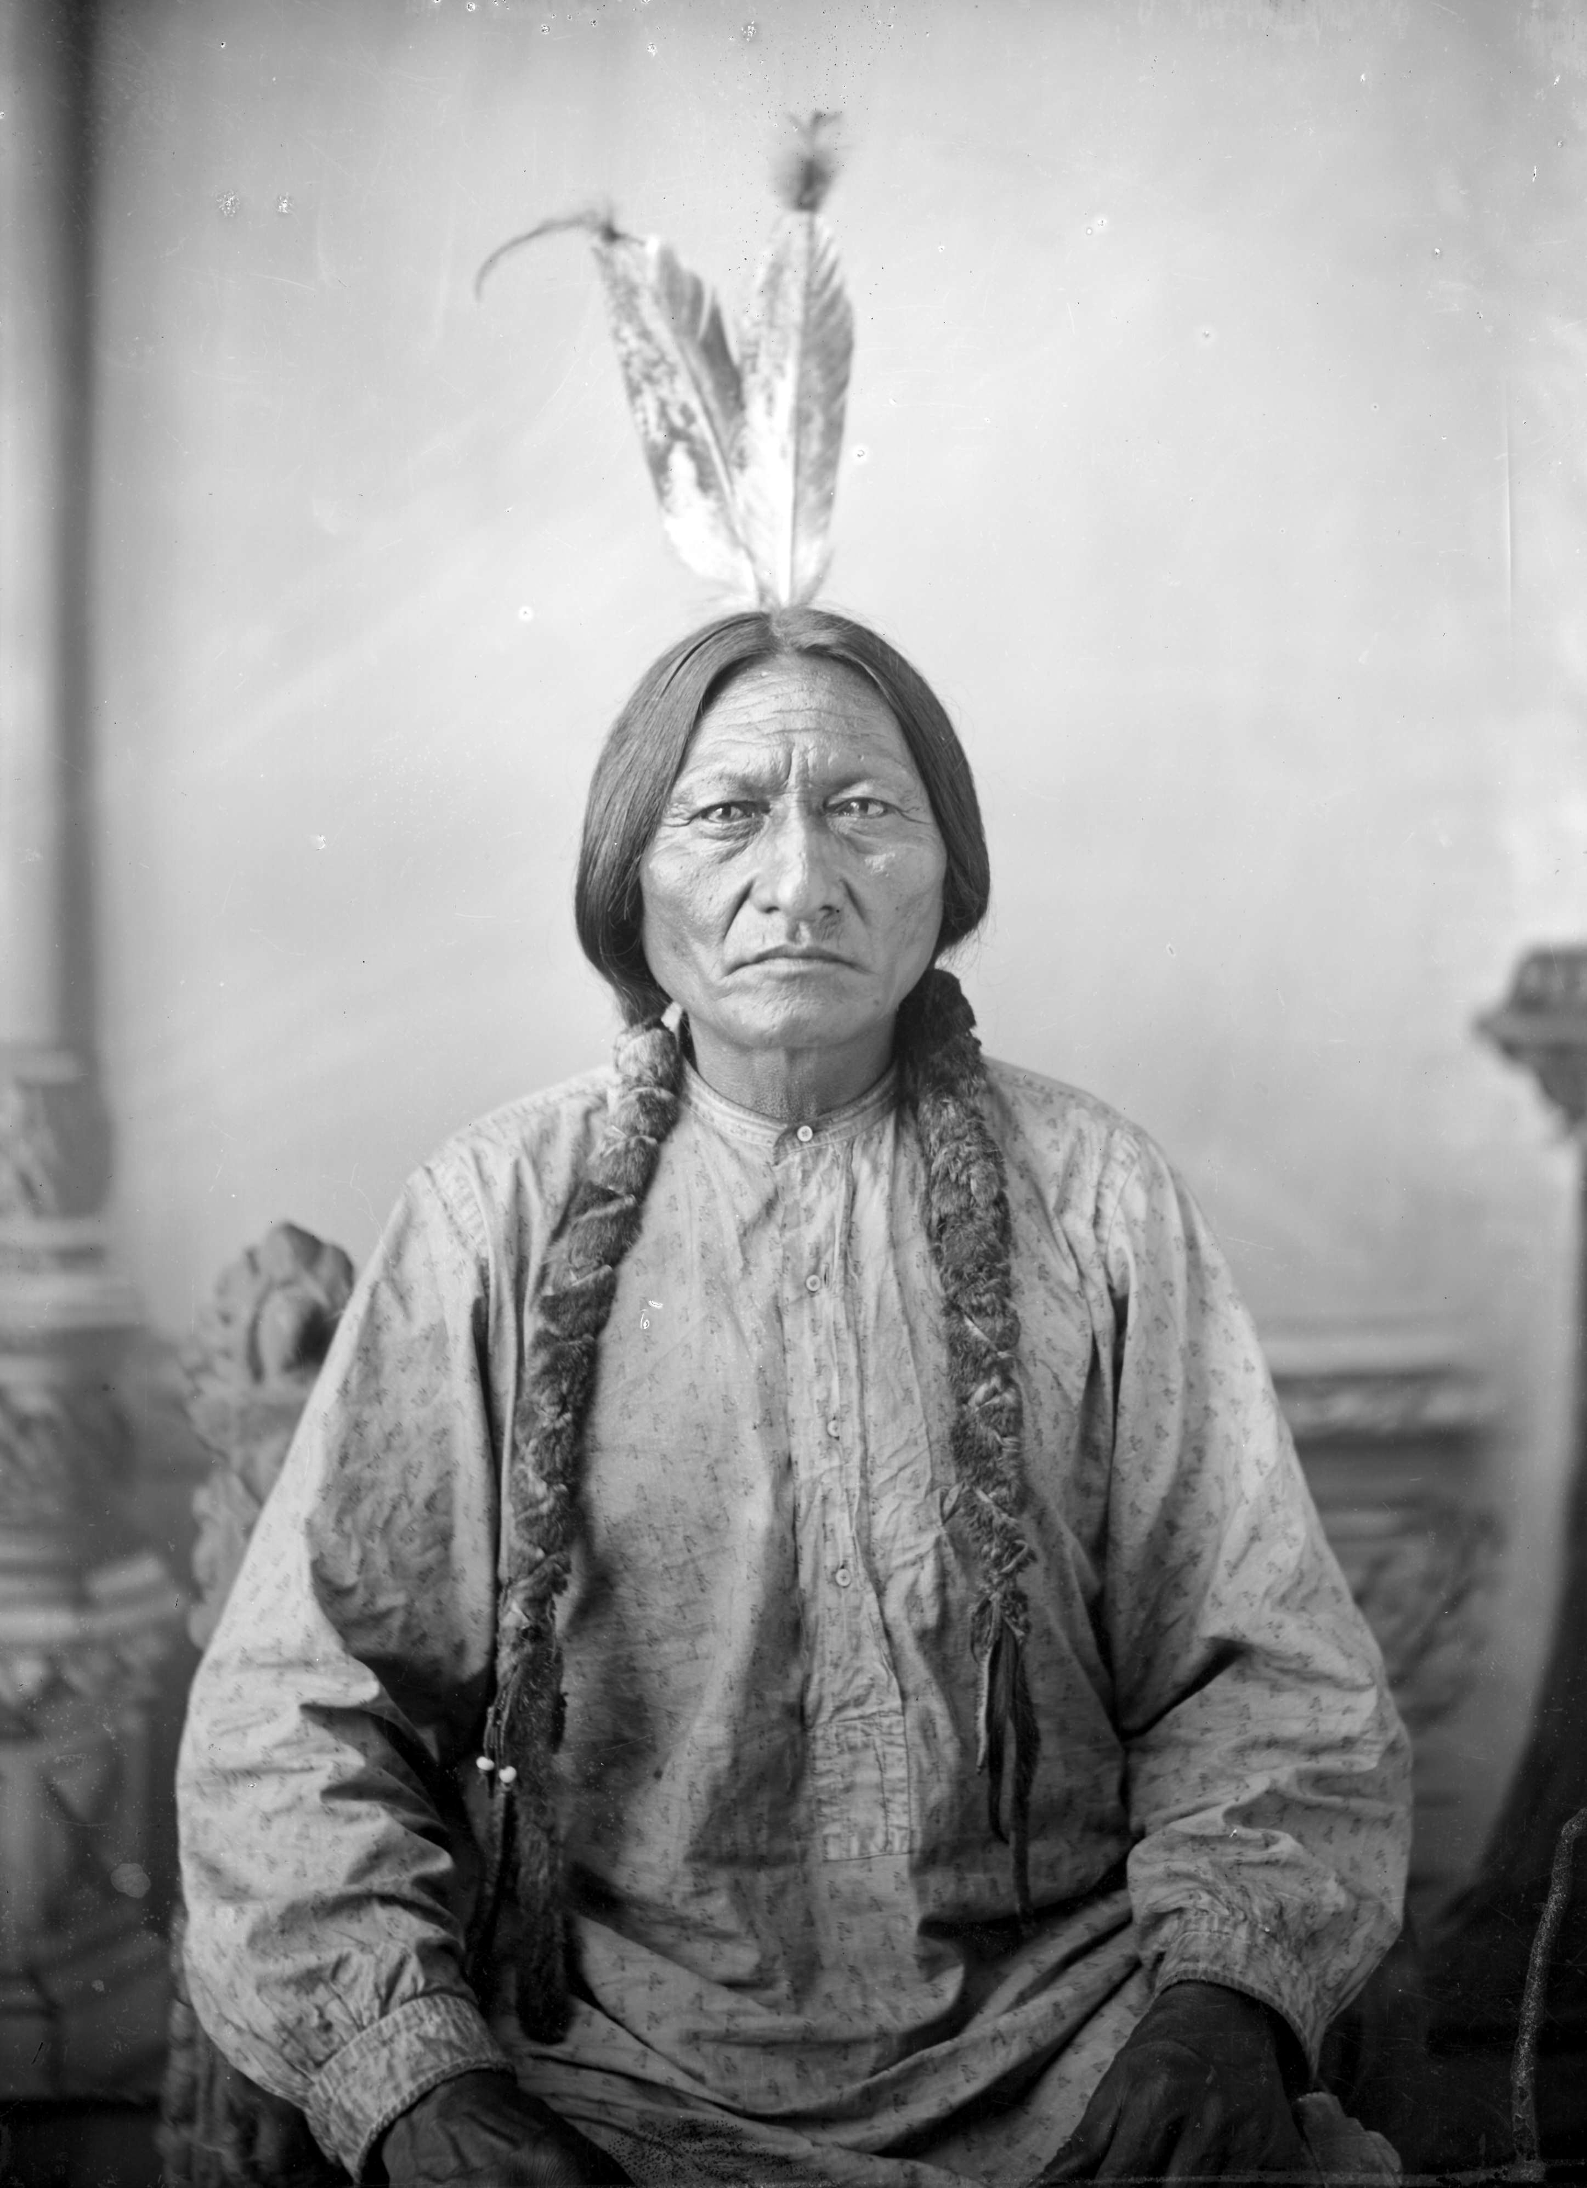
Notes:
Before the Battle of the Little Bighorn, Sitting Bull had a vision in which he saw many soldiers, "as thick as grasshoppers," falling upside down into the Lakota camp, which his people took as a foreshadowing of a major victory in which a large number of soldiers would be killed.

Slide 15
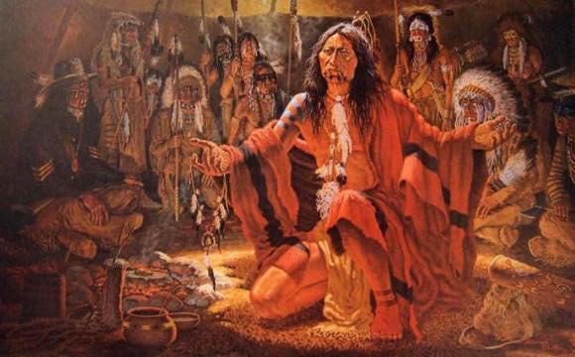
Notes:
In 1875, the Northern Cheyenne, Hunkpapa, Oglala, Sans Arc, and Minneconjou camped together for a Sun Dance, with both the Cheyenne medicine man White Bull or Ice and Sitting Bull in association. This ceremonial alliance preceded their fighting together in 1876.[25] Sitting Bull had a major revelation.
At the climactic moment, "Sitting Bull intoned, 'The Great Spirit has given our enemies to us. We are to destroy them. We do not know who they are. They may be soldiers.' Ice too observed, 'No one then knew who the enemy were – of what tribe.'...They were soon to find out."(Utley 1992: 122–24)
Sitting Bull's refusal to adopt any dependence on the US government meant that at times he and his small band of warriors lived isolated on the Plains. When Native Americans were threatened by the United States, numerous members from various Sioux bands and other tribes, such as the North Cheyenne, came to Sitting Bull's camp. His reputation for "strong medicine" developed as he continued to evade the European Americans.

Slide 16
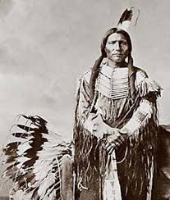
Cray Horse
Notes:
Over the course of the first half of 1876, Sitting Bull's camp continually expanded, as natives joined him for safety in numbers. His leadership had attracted warriors and families, creating an extensive village estimated at more than 10,000 people. Lt. Col. Custer came across this large camp on June 25, 1876. Sitting Bull did not take a direct military role in the ensuing battle; instead he acted as a spiritual leader. A week prior to the attack, he had performed the Sun Dance, in which he fasted and sacrificed over 100 pieces of flesh from his arms.

Slide 17
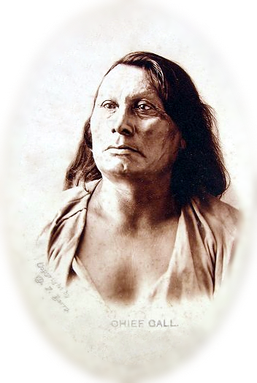

Slide 18
Believed to be 949 lodges (probably 900 – 1,800 warriors) | 31 officers, 566 troopers, 15 armed civilians, ~35–40 scouts

Slide 19
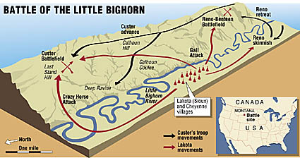

Slide 20
Aftermath

Slide 21
The Greatest Victory, also the last
Larger Armies were sent
By 1876 the sioux & Cheyenne were defeated
Crazy Horse was killed in 1877
Notes:
The Native Americans' victory celebrations were short-lived. Public shock and outrage at Custer's death and defeat, and the government's knowledge about the remaining Sioux, led them to assign thousands more soldiers to the area. Over the next year, the new American military forces pursued the Lakota, forcing many of the Native Americans to surrender.

Slide 22
Sell or Starve and Act of 1877
Cut off all rations until they ceded the Black Hills
Modifies the boundaries of reservations
allows the United States government to establish roads and railroads
Notes:
After the defeat at the Battle of the Little Bighorn in June 1876, Congress responded by attaching what the Sioux call the "sell or starve" rider to the Indian Appropriations Act of 1876 which cut off all rations for the Sioux until they terminated hostilities and ceded the Black Hills to the United States.[32][33]
The Agreement of 1877, also known as the Act of February 28, 1877 (19 Stat. 254), is the most controversial treaty regarding the Black Hills land claims. The treaty officially took away Sioux land, and permanently established Indian reservations. Article 1 of the act modifies the boundaries of reservations stated in the 1868 Fort Laramie Treaty, while Article 2 allows the United States government to establish roads for settlers to travel upon when crossing the territory.[34] Also, article 7 states that only full blood Indians residing on the reservation are allowed to the agreements and benefits from this act as well as past treaties.[35] The controversies around this act state that the government purchased the land from the reservation but there is no valid record of this transaction.[17]

Slide 24
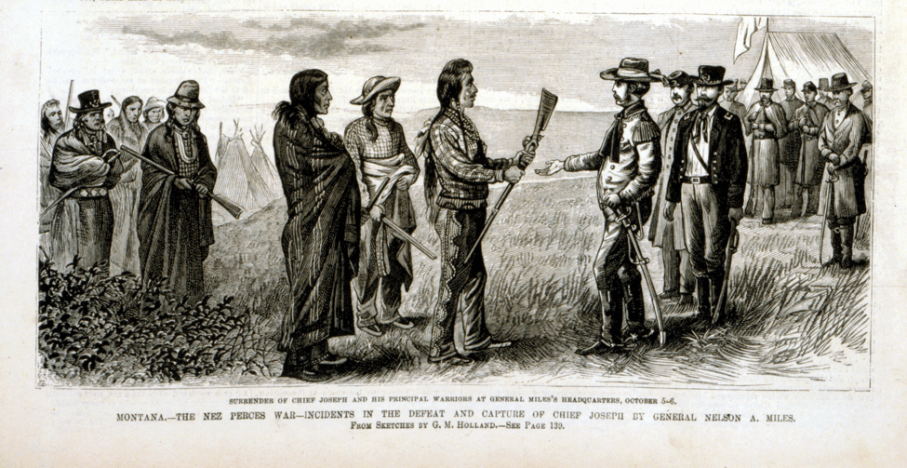

Slide 25
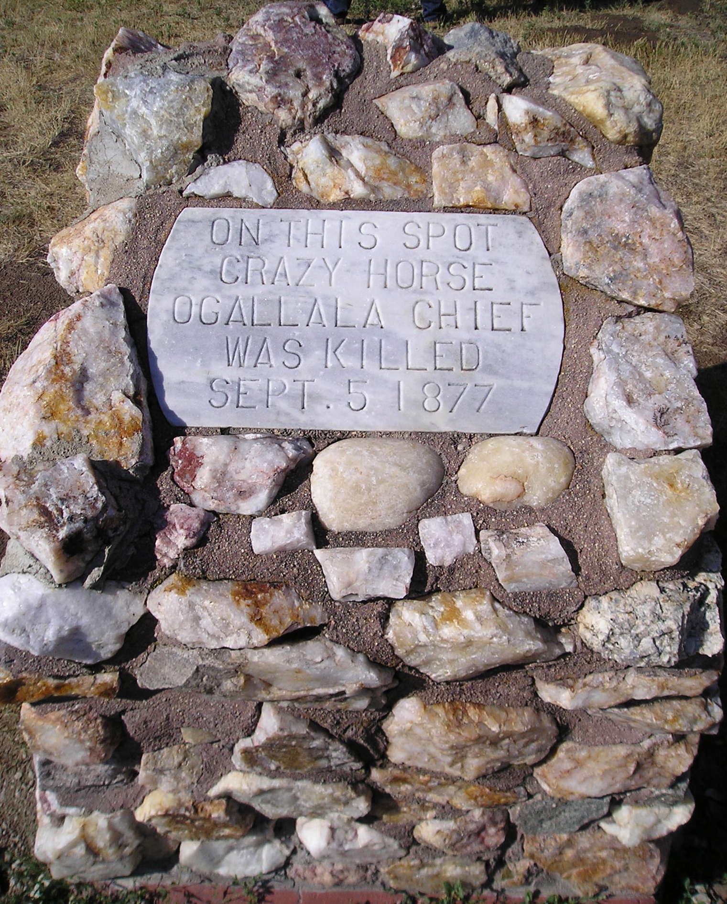

Slide 26
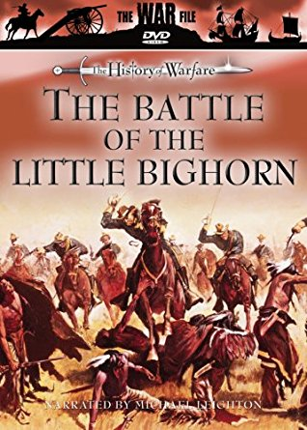

Slide 27
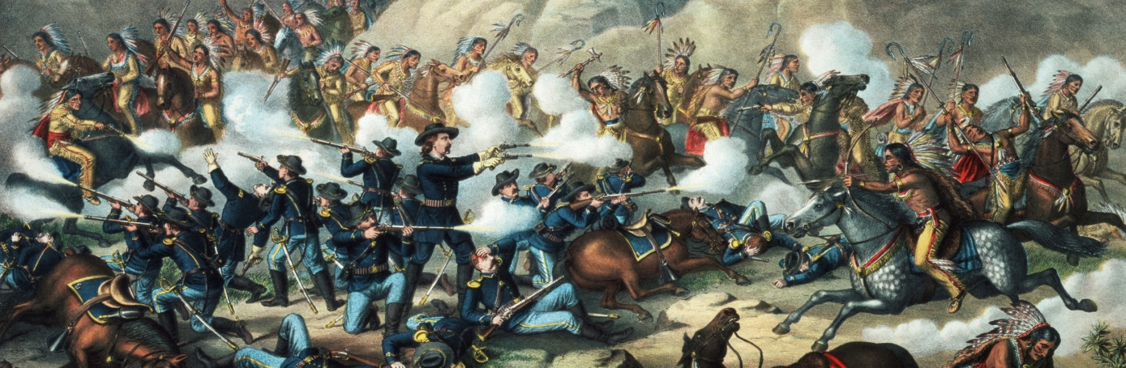

Slide 28
The fate of the brave and gallant Custer has deeply touched the public heart, which sees only a fearless soldier leading a charge against an ambushed foe, and falling at the head of his men and in the thick of the fray.
…an Indian policy intelligent, moral, and efficient. Custer would not have fallen in vain if such a policy should be the result of his death. It is a permanent accusation against our humanity and ability that over the Canadian line the relations between the Indians and whites are so tranquil, while upon our side they are summed up in perpetual treachery, waste, and war.
…The folly of making treaties with the Indian tribes may be as great as treating with a herd of buffalo. But the infamy of violating treaties when we have made them is undeniable, and we are guilty both of the folly and the infamy.
Harper’s Daily
Notes:
Sitting Bull refused to surrender and in May 1877 led his band across the border into the North-West Territories, Canada. He remained in exile for four years near Wood Mountain, refusing a pardon and the chance to return.[30] When crossing the border into Canadian territory, Sitting Bull was met by the Mounties of the region. During this meeting, James Morrow Walsh, commander of the North-West Mounted Police, explained to Sitting Bull that the Lakota were now on British soil and must obey British law. Walsh emphasized that he enforced the law equally and that every person in the territory had a right to justice. Walsh became an advocate for Sitting Bull and the two became good friends for the remainder of their lives.[31]
While in Canada, Sitting Bull also met with Crowfoot, who was a leader of the Blackfeet, long-time powerful enemies of the Lakota and Cheyenne. Sitting Bull wished to make peace with the Blackfeet Nation and Crowfoot. As an advocate for peace himself, Crowfoot eagerly accepted the tobacco peace offering. Sitting Bull was so impressed by Crowfoot that he named one of his sons after him.[32] Sitting Bull and his people stayed in Canada for 4 years. Due to the smaller size of the buffalo herds in Canada, Sitting Bull and his men found it difficult to find enough food to feed his people, who were starving and exhausted. Sitting Bull’s presence in the country led to increased tensions between the Canadian and the United States governments.[33] Before Sitting Bull left Canada, he may have visited Walsh for a final time and left a ceremonial headdress as a memento.[

Slide 29
The savages who know us and who will neither be pauperized nor trust our word we pursue and slay if we can at an incredible expense.
The Indian is undoubtedly a savage, and a savage greatly spoiled by the kind of contact with civilization which he gets at the West. There is generally no interest whatever in him or his fate.
All this should certainly be enough to arouse a public demand for a thorough consideration of the subject, and the adoption of a system which should neither be puerile nor disgraceful, and which would tend to spare us the constant repetition of such sorrowful events as the slaughter of Custer and his brave men.

Slide 30
